Slide 1
Check Inn Hotel Management System
Group 2: Sihui He, Chun Yang, Yuhan Zhang, Yulun Feng

Slide 2
Overview
Introduction, Vision And Scope
Elicitations and Raw Requirements
Analysis Notes
Selected Models
Verification and Validation
ASRs and High-Level Architecture
Prioritized Requirements
Documented Test Cases
Release Plan
Conclusion
Notes:
1-2 Conor 3-4 Sihui 5,7 Allen 6,10 Chun Yang 8-9 Automata

Slide 3
Introduction, Vision And Scope
Canadian Hotel market experiencing rapid growth and evolution driven by advancements in technology and changing consumer preferences. Our client. The rise of online booking platforms and people increasing popularity of using mobile devices for travel planning, hotels must adapt and offer reservation systems and guest-facing mobile applications for various hotel services.

Slide 4
Clients Vision And Scope
To become a First Hotel Brand for young people and Top 1 successful Canadian hotel group.
Provide quality and ethical services with new technology to all our customers, clients and partners at all times
Our client wants to ensure the quality service and products are provided to their guests at competitive prices. Our client strives for a fair return of investment for our stakeholders by practising good management ethics.

Slide 5
Elicitations and Raw Requirements
Elicitation grouped by document：
Analysis Notes — User，IT
Verification and validation — Project Managers and QA Managers
ASR — Architects and IT Staff
Prioritize — PM and Developer
Test Cases — QA team
Release plan — PM, stakeholders, Company wise

Slide 6
Elicitations and Raw Requirements
Decide on elicitation scope and agenda
Prepare resources
Prepare questions and straw man models
Proform elicitation session
Organize and share notes
Document Open issues

Slide 7
Raw Requirements - Functional
Reservation System
Check-in/Check-out
Profile Management
Financial Reporting System
Service Scheduling
User Loyalty Program
Feedback
Data Analysis Function

Slide 8
Raw Requirements - Non- Functional
Data Security
Hardware Compatibility
Train and Support

Slide 9
Analysis Notes From Elicitations - Stakeholders Profiles and Elicitation Methods
Elicitation Methods: Interviewing , Workshops
Stakeholder Profiles:
Direct Users: Customer and Hotel Staff
Directly impacts guest satisfaction and their likelihood to return or recommend the hotel to others.
Hotel Management: Interested in overall project success, return on investment, guest satisfaction scores, and operational efficiency.

Slide 10
Analysis Notes From Elicitations - Stakeholders Profiles and Elicitation Methods
Stakeholder Profiles:
3. IT Department/Technical Team: Ensure system stability and reliability.
4. Legal and Compliance Officers: Ensuring the system complies with relevant regulations

Slide 11
Analysis Notes From Elicitations - Functional Requirements
Eight Major Functional Requirements:
Online Booking and Reservation Management
Check-In/Out and Room Assignment Automation
Guest Profile Management
Dynamic Pricing and Revenue Management
Housekeeping and Maintenance Scheduling
Customer Relationship Management (CRM) Integration
Feedback and Review Management
Data Analytics for Customer Insights

Slide 12
Analysis Notes From Elicitations - Non Functional Requirements
Usability:The system shall feature an intuitive user interface, aiming for a System Usability Scale (SUS) score of at least 85 out of 100.
Performance
Security
Scalability
Reliability
Maintainability
Data Privacy and Protection Compliance: The system must ensure all personal data is processed in compliance with any applicable local data protection laws, providing mechanisms for data access, correction, and deletion requests by users.
Compatibility

Slide 13
Analysis Notes From Elicitations - Assumptions
Users (both hotel staff and guests) have basic digital literacy and can navigate standard web and mobile interfaces without extensive training.
The hotel's existing IT infrastructure is sufficient to support the initial deployment of the hotel management system
Third-party integration partners (such as payment gateways, online booking services, and CRM systems) will provide stable and well-documented APIs for integration.

Slide 14
Analysis Notes From Elicitations - Constraints
The project is subject to a fixed budget, which limits the scope of initial development and prioritizes certain functionalities over others based on immediate business needs and ROI.
The implementation timeline is constrained by the hotel's operational calendar
The system must comply with Canadian data protection laws which govern the processing and movement of guests' personal data.

Slide 15
Analysis Notes From Elicitations - Risk Analysis
Dependency on Third-Party APIs: The project's reliance on third-party APIs for critical functionalities poses a risk if these APIs change, become deprecated, or experience downtime.
Data Migration Challenges: Migrating existing data into the new system encounters unforeseen issues, risking data loss or corruption.
User Adoption Resistance: Hotel staff and guests may resist adopting the new system, limiting its effectiveness and ROI.
Overlooking Regulatory Compliance: Failure to fully comply with all relevant data protection and privacy laws leads to legal and financial repercussions.
Budget Overruns

Slide 16
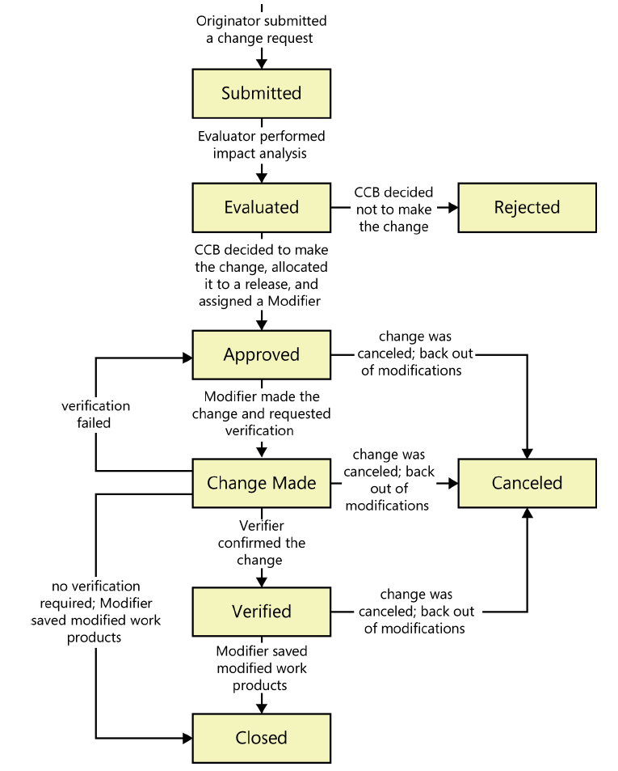
Analysis Notes From Elicitations - Change Management
Originator Submits a Change Request
Submitted Stage
Evaluation Stage
Approved Stage
Change Made Stage
Verified Stage
Closed Stage

Slide 17
Analysis Notes - Swimlane Model
Why choose Swimlane Model?
Clarity in responsibility, offers a clear picture of workflows between different systems
Short Summary for our Swimlane Model
Five key components/stakeholders involved: Guest, System, Hotel Staff, Hotel Manager, Guest Database

Slide 18
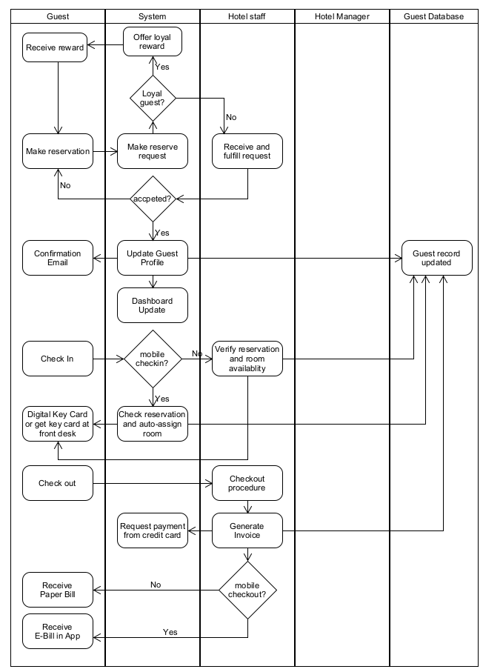
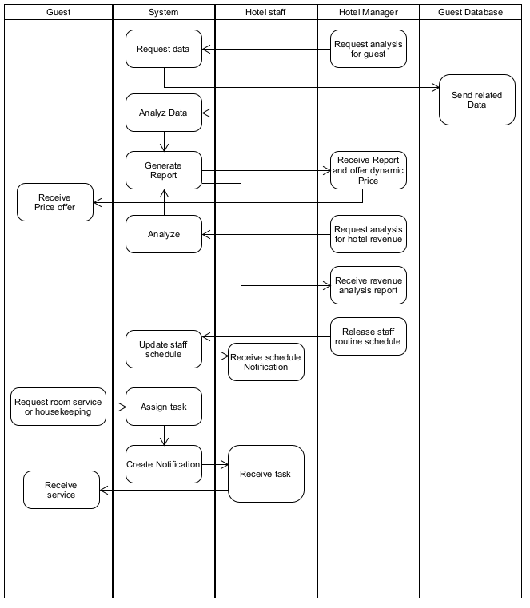

Slide 19
Verification and Validation - Overview
Objective: Ensure the Check Inn #1 Hotel Management System aligns with business requirements and operational goals.
Scope: Encompasses modules like online booking, guest management, and dynamic pricing to enhance guest satisfaction and operational efficiency.
Process: Includes planning, review, defect management, test case development, and acceptance testing.
Engagement: Collaboration with stakeholders (Group 4) for strategy elicitation, focusing on a comprehensive approach to system reliability and performance.

Slide 20
Verification and Validation - Verification
Planning: Define verification scope, identify components, allocate resources, and schedule activities.
Review: Conduct both informal and formal reviews to ensure alignment with design and requirements.
Defect Management: Utilize a tracking system to log, prioritize, and resolve defects.
Criteria: Entry and exit criteria established to ensure thoroughness and readiness for the next phases.

Slide 21
Verification and Validation - Validation
Prototyping & Feedback: Use prototyping to confirm design choices and functional alignment with user and business needs.
Acceptance Testing: Includes User Acceptance Testing (UAT) and Business Acceptance Testing (BAT) to validate system against user requirements and business objectives.
Training & Documentation: Essential for user adaptation and system efficacy.
Post-Deployment: Ongoing monitoring to ensure system performance and user satisfaction.

Slide 22
Architectural Significant Requirements (ASRs)
Our ASRs are influenced by key factors such as business growth, innovation, guest experience enhancement, and operational efficiency.
Main considerations include scalability, modularity, performance and data security.
We aim to not only relive client from current operational issues but also provide a foundation for long-term success.
Our ASRs reflect a commitment to sustainability, personalized care, and ongoing innovation.

Slide 23
Architectural Significant Requirements (ASRs)
Flexibility and Adaptability Requirement
Operational Efficiency Requirement
Guest Experience Enhancement Requirement
Analytics and Insights Requirement
Training and Support Requirement
Compliance with Industry Standards Requirement
API-Based Integration Requirement
Integration Requirement
Scalability Requirement
Microservices Architecture Requirement
Data Security and Privacy Requirement
Reliability and Performance Requirement

Slide 24
Example: Scalability Requirement
Description
The system must be able to scale up and scale down to accommodate varying user loads without compromising performance or reliability. The system needs to be able to grow with the business and handle spikes in user activity during peak periods.
Acceptance Criteria
The system should support at least a 50% increase in concurrent users and transactions compared to current load levels.
Scalability testing should demonstrate that the system can handle a load equivalent to 1000 concurrent users without major outage.

Slide 25
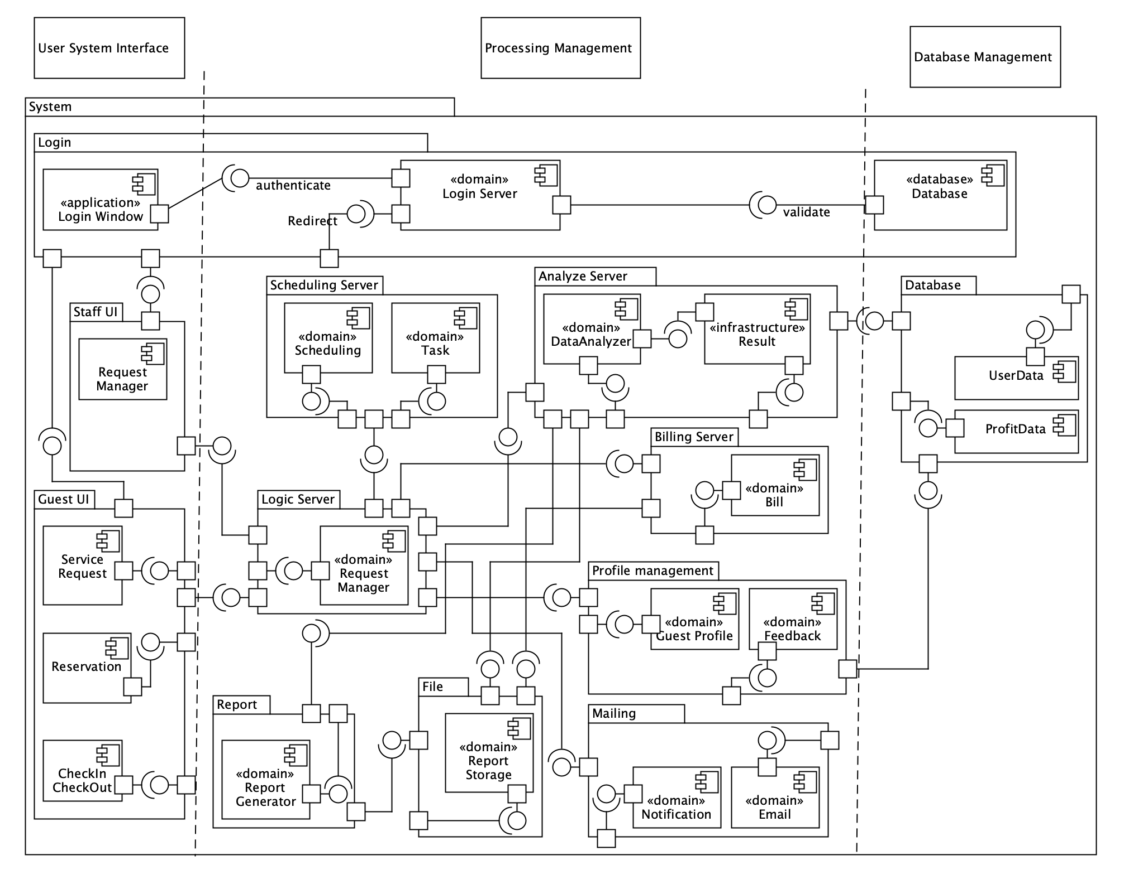
Architectural Significant Requirements (ASRs)

Slide 26
Prioritized Requirements - Framework
Priority Score = (Relative Benefit + Relative Penalty) / (Relative Cost + Relative Risk).
Criteria for High Priority:
Critical for system launch and essential operations.
Direct impact on the project's immediate goals and core functionality.
Examples include Online Booking and Reservation Management, and Check-In/Out Automation.

Slide 27
Prioritized Requirements - Framework
Criteria for Medium Priority:
Important for enhancing system utility and user satisfaction.
Targeted for the next phase post-launch.
Includes features like Dynamic Pricing and Housekeeping Scheduling.
Criteria for Low Priority:
Beneficial but not essential for the initial launch.
Considered for future updates or enhancements.
Examples encompass CRM Integration and Data Analytics.

Slide 28
Prioritized Requirements - High Priority
Online Booking and Reservation Management:
Direct booking interface for guests on the website or mobile app.
Real-time updates on room availability and rates.
Immediate booking confirmation with details sent to guests.
Check-In/Out and Room Assignment Automation:
Mobile device check-in/out for guest convenience.
Automated room assignment based on guest preferences and availability.
Express check-out process for fast and efficient guest departure.

Slide 29
Prioritized Requirements - Medium and Low Priorities
Medium Priority Requirements:
- Dynamic Pricing and Revenue Management:
Implement dynamic pricing based on market demand, occupancy, and special events.
- Housekeeping and Maintenance Scheduling:
Efficient scheduling and tracking of housekeeping tasks.
Low Priority Features:
- CRM Integration:
Leverage CRM data for targeted marketing and guest service personalization.
- Data Analytics for Customer Insights:
Utilize data analytics for trend analysis and strategic decision-making.

Slide 30
Documented Test Cases
In software development, requirements are statements that define the functions, features, or characteristics of a system or product.
Testability is crucial because it ensures that the requirements can be validated and verified through testing processes. Here are 8 key aspects of testability of requirements we deemed necessary:
Clarity and specificity
Measurability
Verifiability
Consistency
Independence
Functional and Non-Functional Requirements testing
Notes:
Automata

Slide 31
Documented Test Cases
6. Traceability
7. Feasibility
8. Testability reviews
By addressing these testabilities in designing our test cases, we were able to effectively and efficiently meet stakeholder needs, and deliver Check Inn™ while optimizing resources and reducing costs
Functional and Non-Functional Requirements testing
Notes:
Automata

Slide 32
Documented Test Cases - Functional Requirements
No. | Description | Expected Results | Actual Results | Severity | Test Status
01 | Booking Application User Interface | Room booking, Room viewing, Reservation management, Inventory update | Passed
02 | Check-In/Out and Room Assignment Automation | Mobile check-in/check-out, Room changes and upgrades, Maintenance update | Passed
Severity Legends
Test Status Legends
Critical
High
Normal
Pass
Fail
In Progress
Notes:
Automata

Slide 33
Documented Test Cases - Functional Requirements
No. | Description | Expected Results | Actual Results | Severity | Test Status
03 | Guest Profile Management | Profile accessing, Profile updating, Guest feedback, Guest Personalization | Passed
04 | Hotel Management Automation | Real-time pricing, Trend analysis, Personalized offer, Preference special rates | Passed
Severity Legends
Test Status Legends
Critical
High
Normal
Pass
Fail
In Progress
Notes:
Automata

Slide 34
Documented Test Cases - Functional Requirements
No. | Description | Expected Results | Actual Results | Severity | Test Status
05 | Housekeeping and Maintenance Scheduling | Task scheduling, Room status notification, Maintenance check, Housekeeping request | Passed
06 | Customer Relationship Management (CRM) Integration | Marketing campaigns, Loyalty program, CRM data analysis, | Working on improving the significance of CRM data analysis report
Severity Legends
Test Status Legends
Critical
High
Normal
Pass
Fail
In Progress
Notes:
Automata

Slide 35
Documented Test Cases - Functional Requirements
No. | Description | Expected Results | Actual Results | Severity | Test Status
07 | Feedback and Review Management | Feedback collection, Online review management, Feedback-driven Improvements | Passed
08 | Data Analytics for Customer Insights | Guest behavior and preferences, staffing resource allocation, Guest satisfaction benchmark | Failed to provide efficient staffing plan that meet the requirement
Severity Legends
Test Status Legends
Critical
High
Normal
Pass
Fail
In Progress
Notes:
Automata

Slide 36
Documented Test Cases - Non-Functional Requirements
No. | Description | Specifications | Current Results | Severity | Test Status
01 | Intuitive User Interface | 50 participants in System Usability Scale(SUS), Task completion rate | > 80/100 SUS 99% Completion rate
02 | System Performance under Load | 10,000 simulated users simultaneously | Error rate < 5%
03 | Data Security and Compliance | HTTPS, TLS, GDPR Compliance assessment | System-wide Implementation
Severity Legends
Test Status Legends
Critical
High
Normal
Pass
Fail
In Progress
Notes:
Automata

Slide 37
Documented Test Cases - Non-Functional Requirements
No. | Description | Specifications | Current Results | Severity | Test Status
04 | System Scalability | Resource utilization analysis, Dynamic resource allocation | Optimal resource utilization (< 50%)
05 | System Reliability and Uptime | Uptime monitoring, Recovery Time Objective (RTO) Testing | 99.9% uptime RTO within hours
06 | Cross-Platform Compatibility | Major mobile/web compatibility | Platform test passed
Severity Legends
Test Status Legends
Critical
High
Normal
Pass
Fail
In Progress
Notes:
Automata

Slide 38
Release Plan
This release plan outlines the phased approach to rolling out the Check Inn™ Hotel Management System. The plan is structured to ensure that critical features are launched efficiently, aligning with the prioritized requirements to maximize business value and stakeholder satisfaction.
Deliverable Phases and Post-Release Support
Notes:
Automata

Slide 39
Release Plan
Phase 1
Phase 2
Phase 3
Post-Release
Objective:
Establish the foundational elements of the system to ensure operational functionality and immediate business impact.
Features to Include:
- Online Booking and Reservation Management
- Check-In/Out and Room Assignment Automation
- Guest Profile Management
- Basic CRM Integration
- Data Security and Compliance
Timeline: 0-3 Months
Goals:
- Establish a robust online booking system.
- Automate room assignment and check-in/out processes.
- Ensure data integrity and security.
Notes:
Automata

Slide 40
Release Plan
Phase 1
Phase 2
Phase 3
Post-Release
Objective:
Introduce features that enhance operational efficiency and staff productivity.
Features to Include:
- Housekeeping and Maintenance Scheduling
- Advanced CRM Integration
Timeline: 4-6 Months
Goals:
- Streamline housekeeping and maintenance operations.
- Leverage deeper CRM insights for personalized guest experiences.
Notes:
Automata

Slide 41
Release Plan
Phase 1
Phase 2
Phase 3
Post-Release
Objective:
Implement advanced features that optimize revenue management and enhance guest experiences.
Features to Include:
- Dynamic Pricing and Revenue Management
- Feedback and Review Management
- Data Analytics for Customer Insights
Timeline: 7-12 Months
Goals:
- Optimize pricing strategies to enhance revenue.
- Gather and utilize guest feedback for continuous improvement.
- Leverage analytics for informed decision-making.
Notes:
Automata

Slide 42
Release Plan
Phase 1
Phase 2
Phase 3
Post-Release
- Continuous Monitoring: Regularly monitor system performance, user feedback, and business metrics to ensure system stability and effectiveness.
- Iterative Improvements: Based on feedback and emerging business needs, iteratively enhance and expand system features.
- Security Updates: Consistently update security protocols and conduct regular audits to protect against new vulnerabilities.
Notes:
Automata

Slide 43
Vision and Scope
Raw requirements
Analysis and modeling
Validation
Architectural Design
Elicitation
Interview
SRS
Release plan
Prioritise requirements
Verification plan
Summarize test cases

Slide 44
Thank you

